Slide 1
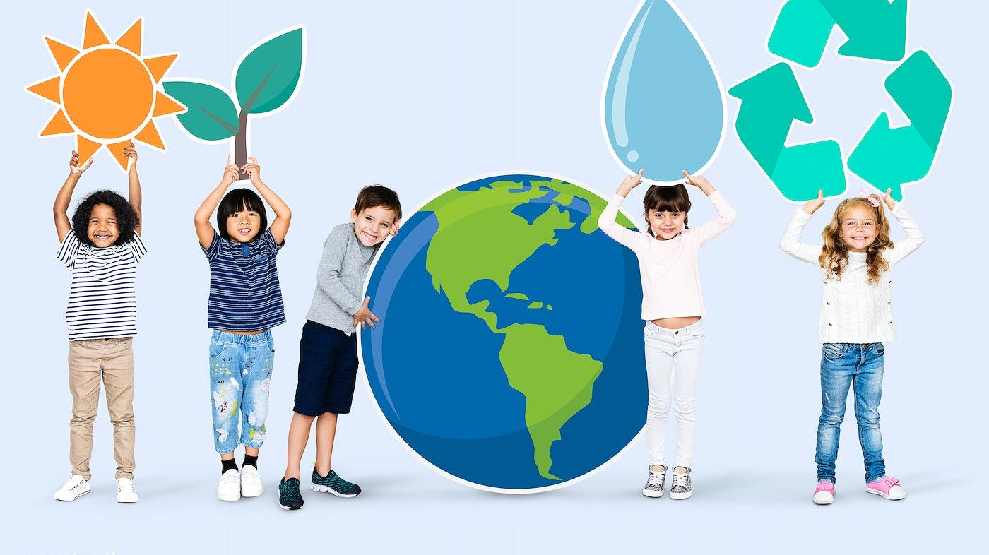
Writting
Humans and the environment

Slide 2
Matching the suggestions for protecting the environment with their expected results:
Suggestions
Expected results
Reduce, Reuse, and Recycle:
Switch to Renewable Energy Sources:
Plant More Trees:
a., This helps to combat climate change, and also improves air quality, provides habitat for wildlife, and prevents soil erosion.
b. This can help reduce greenhouse gas emissions, mitigate climate change and reduce air pollution, leading to improved public health
c. This can significantly decrease the amount of waste that ends up in landfills, reducing soil and water pollution. It also conserves natural resources and energy that would otherwise be used to produce new items.

Slide 3
Answer keys:
Reduce, Reuse, and Recycle: Minimize the amount of waste we produce by reducing consumption, reusing items, and recycling materials. This can significantly decrease the amount of waste that ends up in landfills, reducing soil and water pollution. It also conserves natural resources and energy that would otherwise be used to produce new items.
Switch to Renewable Energy Sources: Using renewable energy sources like solar, wind, and hydropower instead of fossil fuels can significantly reduce greenhouse gas emissions. This can help mitigate climate change and reduce air pollution, leading to improved public health.
Plant More Trees: Trees absorb carbon dioxide, a key greenhouse gas, helping to combat climate change. They also improve air quality, provide habitat for wildlife, and prevent soil erosion.

Slide 4
Fill in the blanks with the words and phrases from the box
In the current era, environmental protection has become a crucial issue. It is our responsibility to take steps to protect our planet. This essay will discuss some effective ways to protect the environment.
First, one of the most impactful ways to protect the environment is by reducing, reusing, and recycling. For example, instead of buying single-use plastic bottles, we can use reusable water bottles. This not only reduces the amount of plastic waste but also saves money in the long run.
Another significant way to protect the environment is______
Furthermore,__________
In conclusion, protecting the environment requires collective effort and conscious choices. By reducing, reusing, recycling, conserving energy, and planting trees, we can make a significant contribution to environmental protection. It is important to remember that every small step counts and can lead to a big difference in the long run.

Slide 5
Add two more suggestions to improve the environment in your school to complete the paragraph. You can use idea in 1 to help you
In the current era, environmental protection has become a crucial issue. It is our responsibility to take steps to protect our planet. This essay will discuss some effective ways to protect the environment.
_______, one of the most impactful ways to protect the environment is by reducing, reusing, and recycling. __________, instead of buying single-use plastic bottles, we can use reusable water bottles. This not only reduces the amount of plastic waste but also saves money in the long run.
Another significant way to protect the environment is
Furthermore,
_______, protecting the environment requires collective effort and conscious choices. By reducing, reusing, recycling, conserving energy, and planting trees, we can make a significant contribution to environmental protection. It is important to remember that every small step counts and can lead to a big difference in the long run.

