Slide 1

Speaking
Humans and the environment:

Slide 2
Which of the following activities do you think we should or shouldn’t do to protect our environment? Why?
 | Should | Shouldn’t
Buy fast fashion:
Drive too much:
Buy single-use items:
Save energy:
Plant more trees:
Use renewable energy sources:
Drink bottled water:
Throw out items in good condition:
Recycle used items:

Slide 3
Answer keys:
What we should do:
1. Recycle used items: This helps protect natural resources.
2. Plant more trees: Trees clean our air.
3. Save energy: Turn off all electrical devices when not in use.
4. Use renewable energy sources: Such as the sun, wind, and water instead of using fossil fuels.
What we shouldn't do:
1. Drive too much: One of the largest contributors to pollution is the gas emission that comes from cars.
2. Buy fast fashion: The fashion industry is responsible for 10 percent of global emissions.
3. Throw out items in good condition: This causes a perfectly good item to end up in a landfill.
4. Buy single-use items: We all tend to rely on plastic wrap and single-use plastic bags.
5. Drink bottled water: Plastic can take up to 450 years to biodegrade.

Slide 4
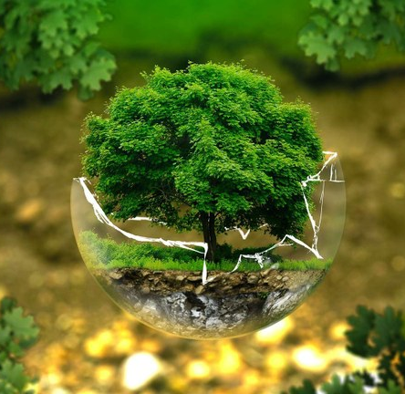
Present your ideas about what we should or shouldn’t do to protect our environment:
This Photo by Unknown Author is licensed under CC BY

