Slide 1
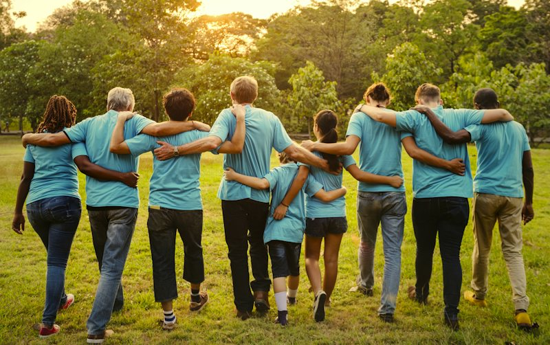
Speaking
Benefit of volunteering activities to the community

Slide 2
Choose the three most important benefits of volunteering activities to the community? Why?
1. Sense of Purpose:
2. Social interaction
3. Improves social skills
4. Improve self-esteem
5. Community development.

Slide 3
The additional reasons:
Sense of Purpose: Volunteering can provide you with a sense of purpose, especially if you’re part of something greater than yourself.
Social Interaction: Volunteering is a great way to meet new friends and strengthen existing connections with friends, family, or coworkers. It allows you to interact with people from diverse backgrounds and learn other perspectives.
Improves Social Skills: Volunteering gives you a chance to talk to new people and sharpen your social skills. The training and hands-on experience you gain while volunteering can help you learn new skills as well as build upon ones you already have.
Improves Self-Esteem: Volunteering may boost your self-esteem and self-confidence.
Community Development: Volunteering can act as a catalyst for community development and change.

Slide 4
Speak about the benefits of volunteering activities
Use the ideas you have learnt from the previous activities and the expression below:
1. First of all,
2. Second,
3. Third,
4. Finally,
5. For example,…./ For instance,...
6. ….. Such as……..

