Slide 1

Listening
Human changes to the environments

Slide 2
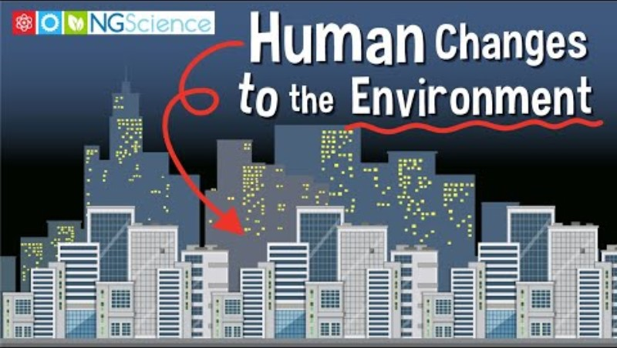
Watch this video
(3) Human Changes to the Environment - YouTube

Slide 3
Watch the video again and answer these questions:
What are the 4 resources mentioned in the video?
What are the results of making roads, tall buildings, and parks?
What does the speaker want everyone to remember?

Slide 4
Answer keys
1. Air, Water, soil, woods
2. It changes the home of plants and animals
3. We share our world with other living things and we need to take care of it for everyone

